Slide 1







Slide 2

INTRODUCTION
PRESENTED TO :
Ansarul Islam
Lecturer
Dept. CSE
PRESENTED BY :
Afsana Kabir
182002068
Razia Sultana
182002079

Slide 3
AUTO CAD
2D FLOOR PLAN WITH COLOR

Slide 4
REQUIRMENTS FOR THIS PROJECT:
Auto CAD 2018
HATCH ( For color )
SUPERHATCH (image)
IMAGEATTACHMENT(image)
Line
Blocks CAD design
Layer
Rectangle
SP line
Trim tool
Break
Offset
Ortho (f8)
Dimension
Text
REQUIREMENT

Slide 5





Slide 6
There are two units of a house
Ground floor .
Upper floor.
2D FLOOR PLAN
In architecture and building engineering,
a floor plan is a drawing to scale, showing a view from above,
of the relationships between rooms, spaces, traffic patterns, and
other physical features at one level of a structure.

Slide 7
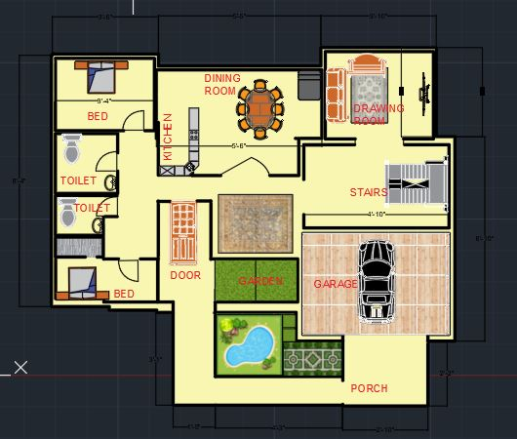
Ground Floor
Two bed rooms.
Two toilets.
Kitchen.
Garden.
Garage.
Porch.
Dinning room.
Drawing room.
Furniture.
Pool.
Car.

Slide 8
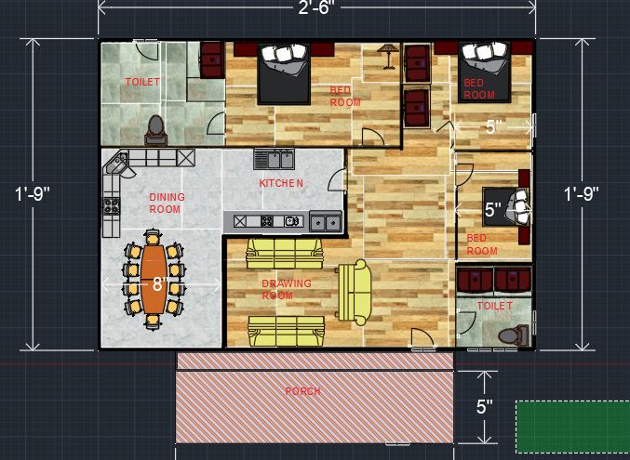
Upper Floor
Three bed rooms.
Two toilets.
Kitchen.
Porch.
Dinning room.
Drawing room.
Furniture.

Slide 9
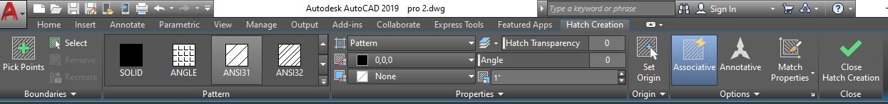
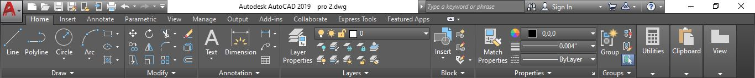
COLOR AND PATERN
FEATURS THAT ARE USED FOR CREATING FLOOR

Slide 10

THANKS
ANY QUESTION

